Slide 1


CVCS Escapement Modeling
Coding the CVCS Escapement Model
Presented by:
Arthur Barros, California Department of Fish and Wildlife
Arthur.Barros@wildlife.ca.gov

Slide 2
Session goals
Review the escapeMR package structure and methods.
Review the demo data.
Replicate CVCS escapement methods in R script.

Slide 3

Workshop GitHub
https://github.com/arthurbarros-CDFW/CVCS-Modeling-workshop

Slide 4




Prepping to code - packages
Packages:
tidyverse
escapeMR
ggplot2
rcpp

Slide 5
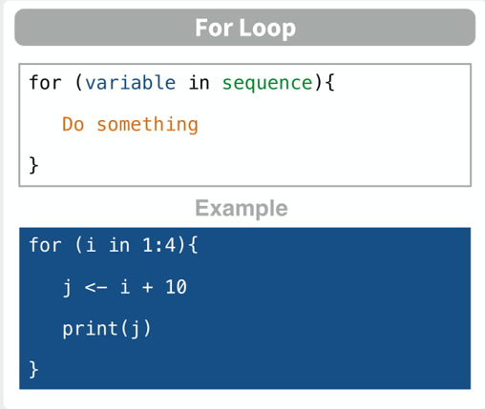
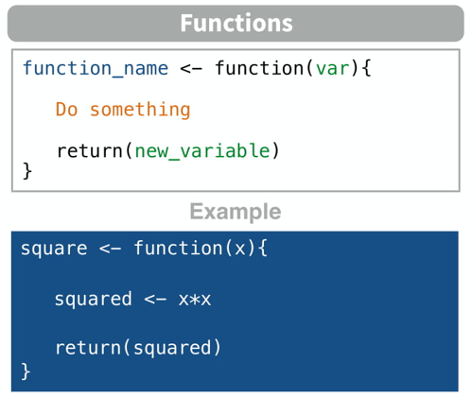
Prepping to code – functions and for loops
Writing for loops: https://www.geeksforgeeks.org/for-loop-in-r/
Writing functions: https://dept.stat.lsa.umich.edu/%7Ejerrick/courses/stat701/notes/functions.html
Notes:
When ever you see a sum or product sign in our equations, that’s a good indicator we’ll be using a for-loop. Equations we use will be written as functions.

Slide 6
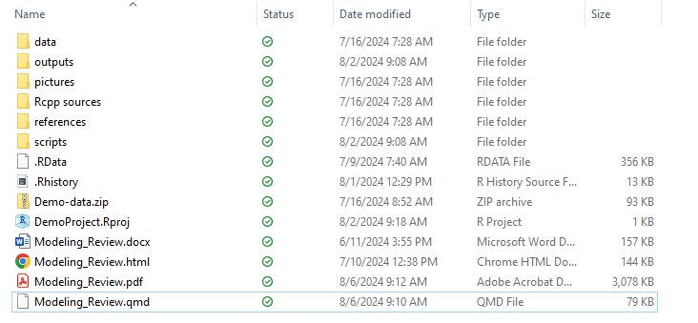
Prepping to code – project directory

Slide 7
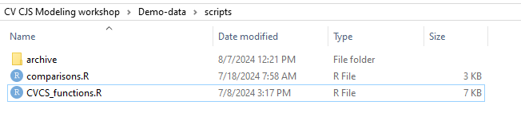
Prepping to code – project directory

Slide 8
Reviewing the escapeMR package

Slide 9
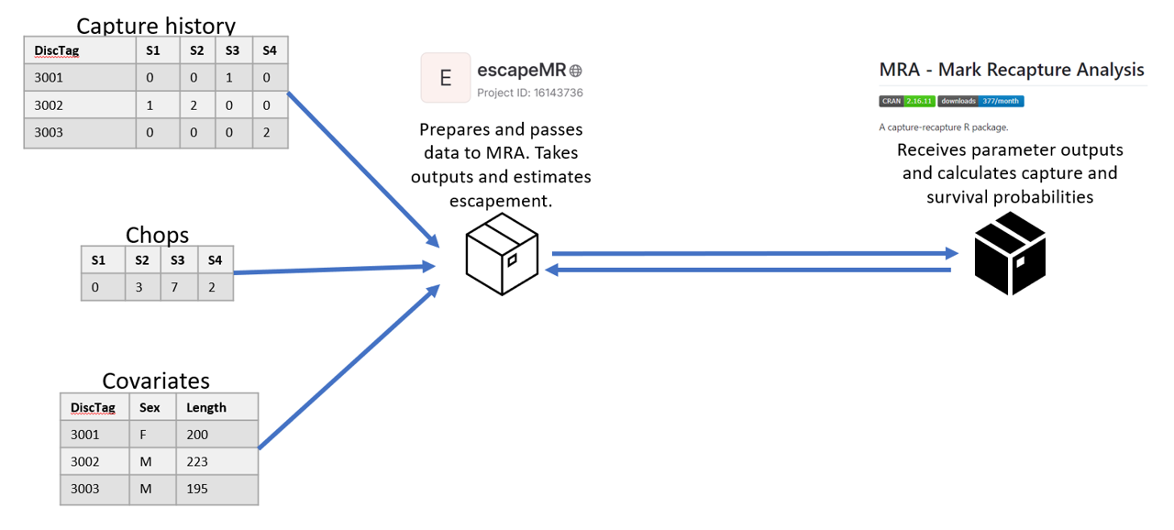
Reviewing the escapeMR package

Slide 10
Reviewing the escapeMR package
escapeMR:
escapeMR.R – loads and runs shiny application.
askForData.R – prompts user for data inputs.
CJSscript.R – script-based version of shiny application.
esc_model.R – passes formatted data to the mra package using the F.cjs.estim() call.
mra:
F.cjs.estim.R – receives input data from escapeMR, and sets initial parameters.
Mrawin.f90 – FORTRAN script with many subroutines used in estimating log-likelihood and finding MLE.
Contains subroutine “VA09AD” MLE algorithm.

Slide 11
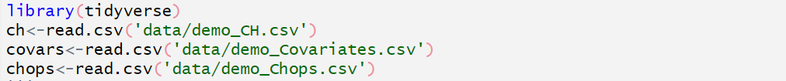
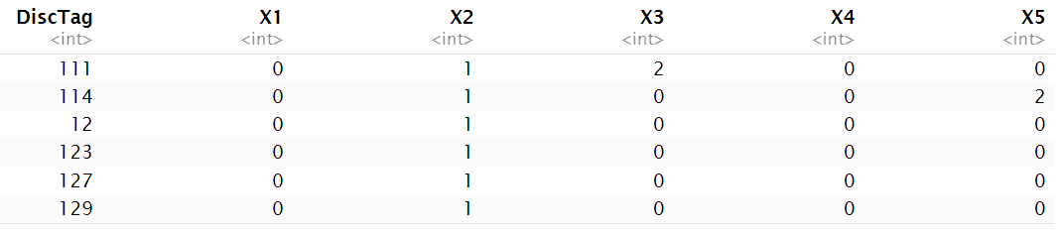
Reviewing demo data
nan=153, ns=5

Slide 12
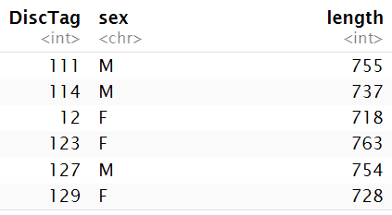
Reviewing demo data

Slide 13
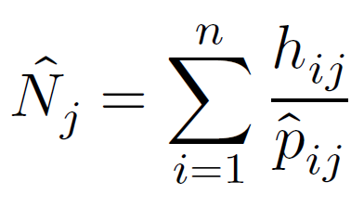
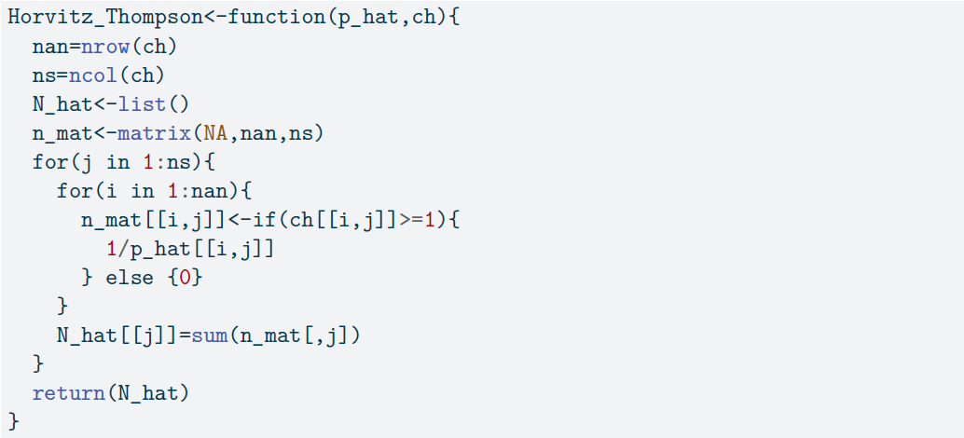
Coding – Horvitz_Thompson()

Slide 14
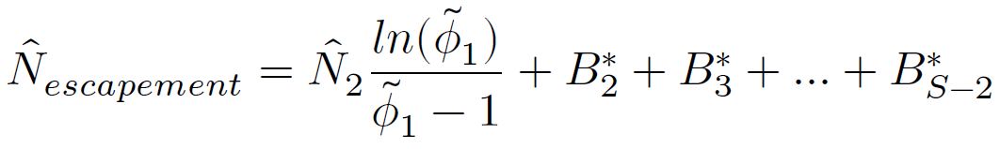
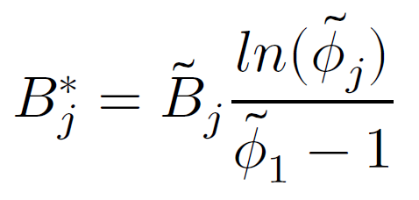
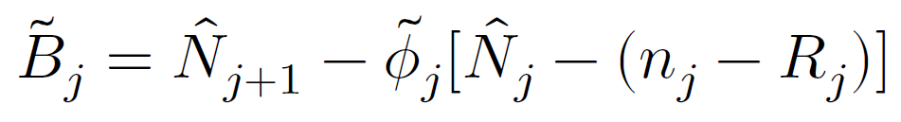
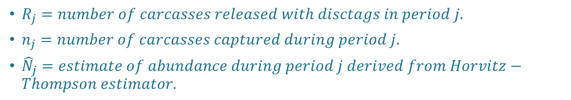
Coding – superpopulation model
${\tilde{B}}_{j}=total births for period j.$
$R_{j}=number of carcasses released with disctags in period j.$
$n_{j}=number of carcasses captured during period j.$
${\hat{N}}_{j}=estimate of abundance during period j derived from Horvitz−Thompson estimator.$

Slide 15
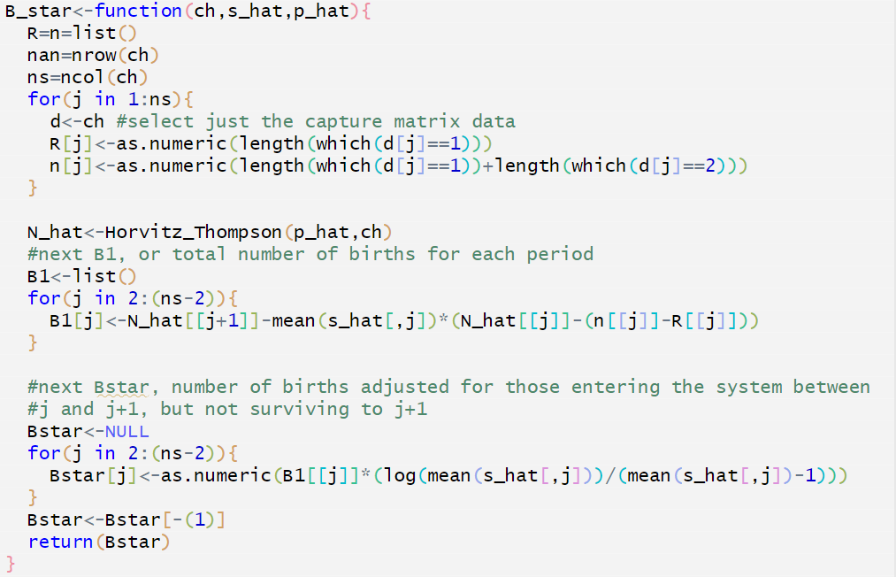
Coding – B_star()
Notes:
Note that we only run B_star for ns-2, based on our equation for N_escapement.

Slide 16
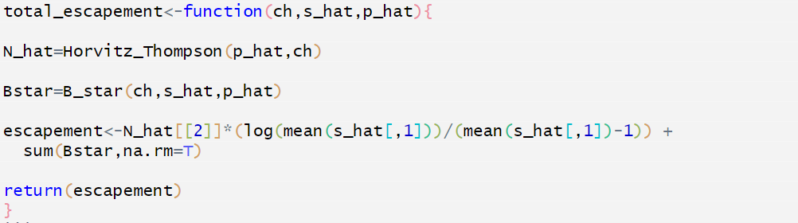
Coding – total_escapement()

Slide 17
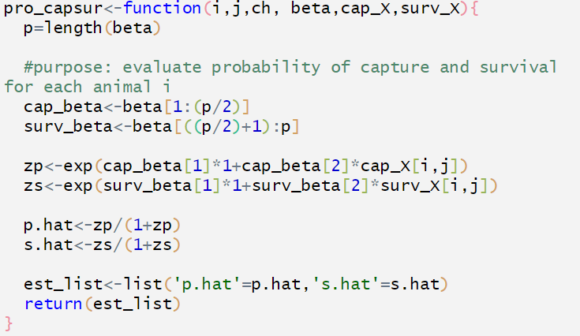
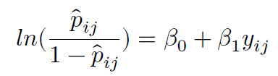
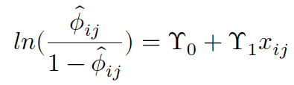
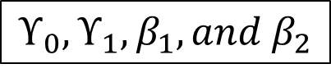
Coding – pro_capsur
$$ϒ_{0}, ϒ_{1}, β_{1}, and β_{2}$$

Slide 18
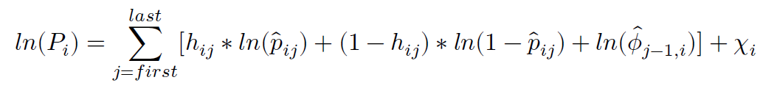
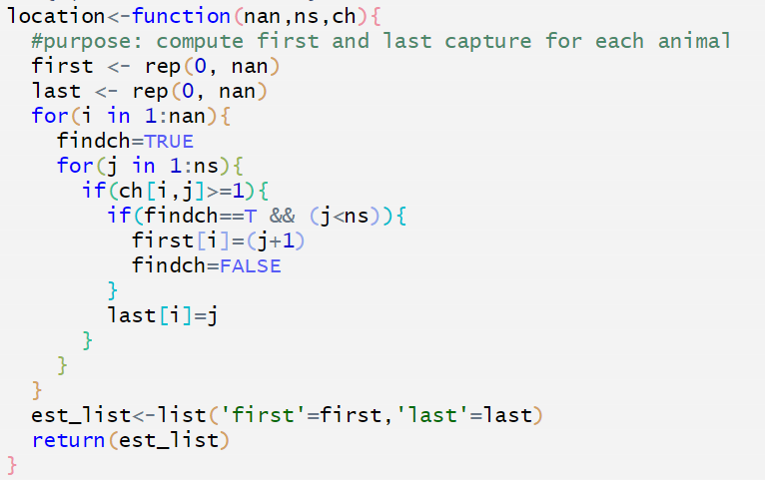
Coding – location()

Slide 19
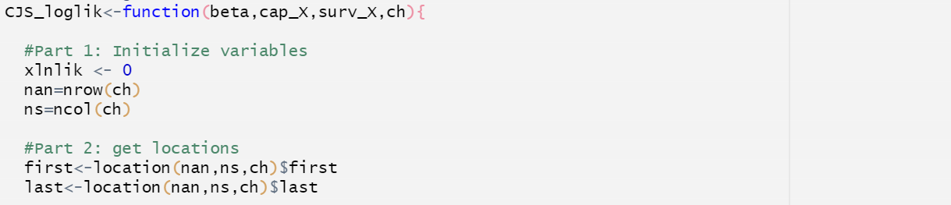
Coding – CJS_loglik()
Notes:
Denote what all the inputs are.

Slide 20
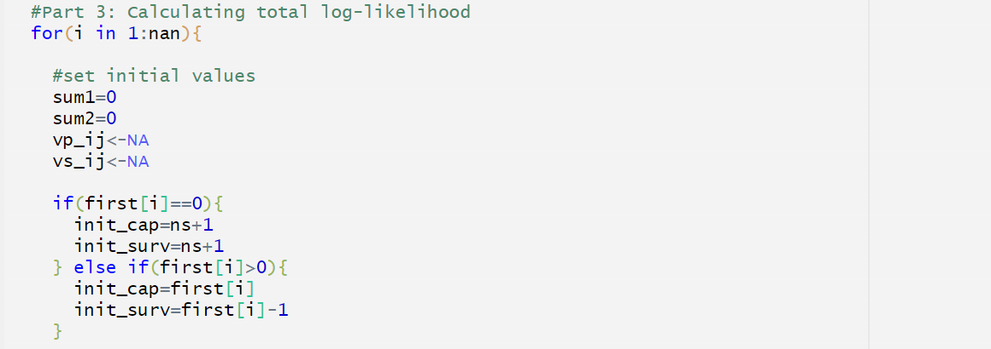
Coding – CJS_loglik()
Notes:
Denote what sum1 and sum2 represent on the equation
First(i) is never 1, because subroutine location sets first to 1 occasion after the first encounter = first estimable capture probability.
Note first(i) = 0 for histories with first capture at the last occasion

Slide 21
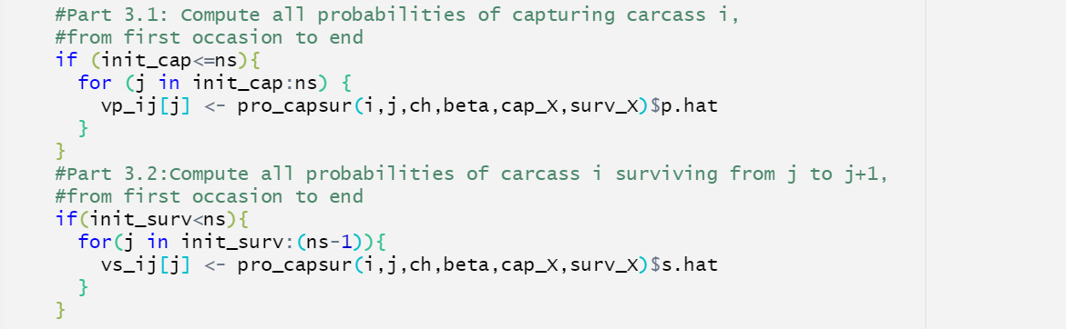
Coding – CJS_loglik()

Slide 22
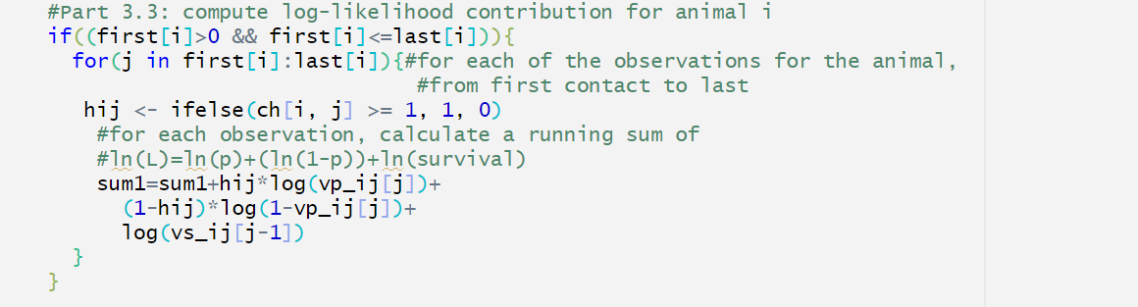
Coding – CJS_loglik()

Slide 23
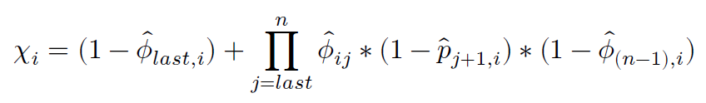
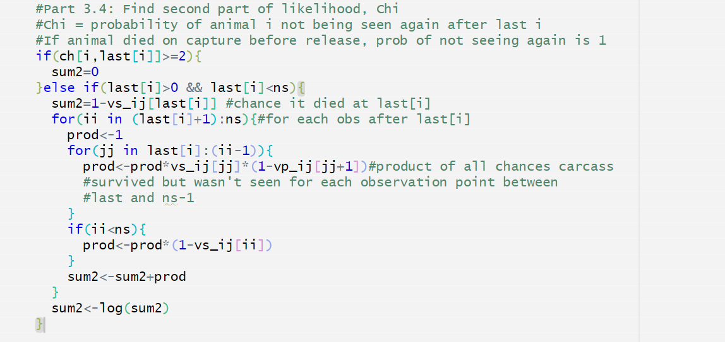
Coding – CJS_loglik()

Slide 24
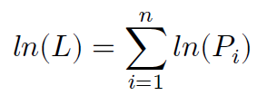
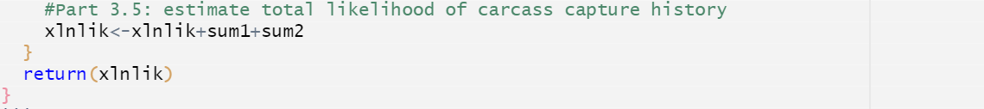
Coding – CJS_loglik()

Slide 25
Coding – CJS_loglik_wrapper()
We’ll be using the optim() call in R to find the MLE.
R optim() is a general-purpose optimization function.
optim() minimizes a function.
Using a “wrapper” function:
Allows us to maximize the function with a sign change.
Allows us to pass additional arguments that will not be optimized.

Slide 26
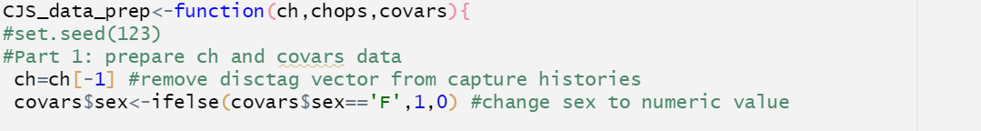
Coding – CJS_data_prep()
Data preparation function.
Deals with chopped data and sex and length covariates.

Slide 27
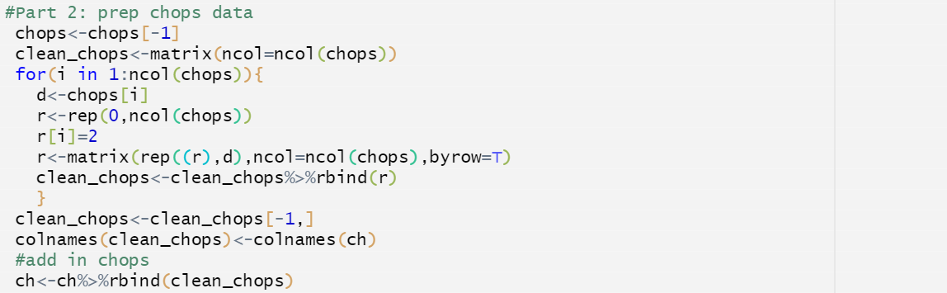

Coding – CJS_data_prep()

Slide 28
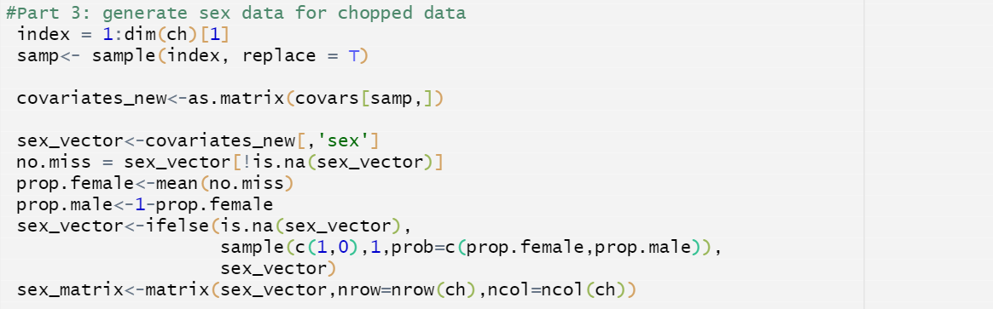
Coding – CJS_data_prep()

Slide 29
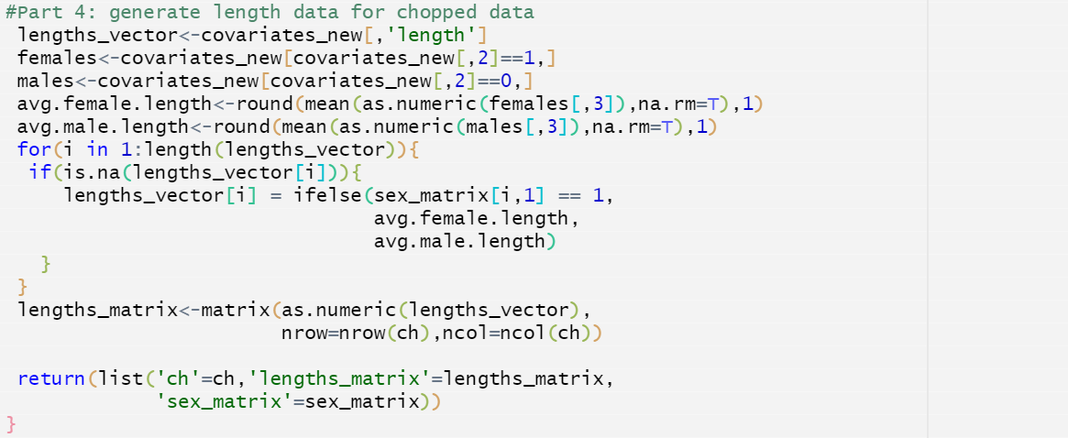
Coding – CJS_data_prep()

Slide 30
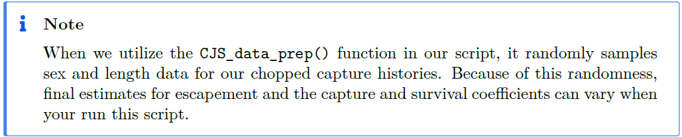
Coding – CJS_data_prep()

Slide 31
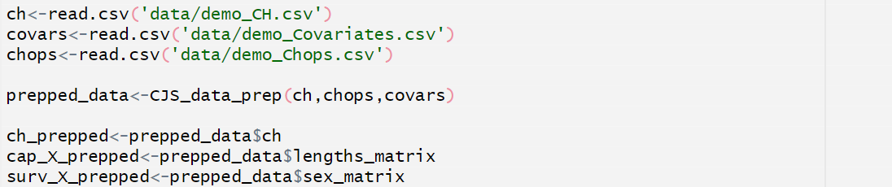
Running code – prepare data
Load demo data
demo_CH.csv
demo_Covariates.csv
demo_Chops.csv
Prep data with CJS_data_prep()

Slide 32
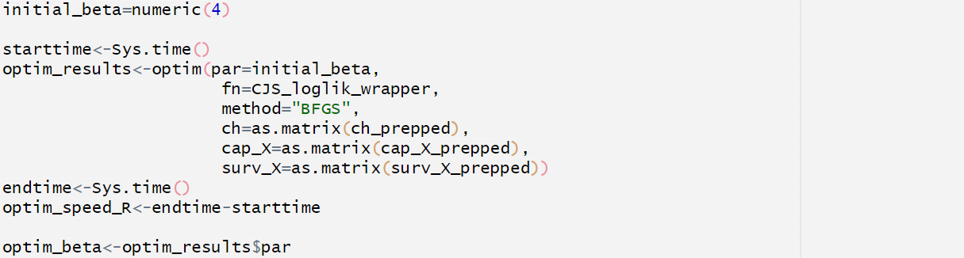
Running code – optimize parameters

Slide 33
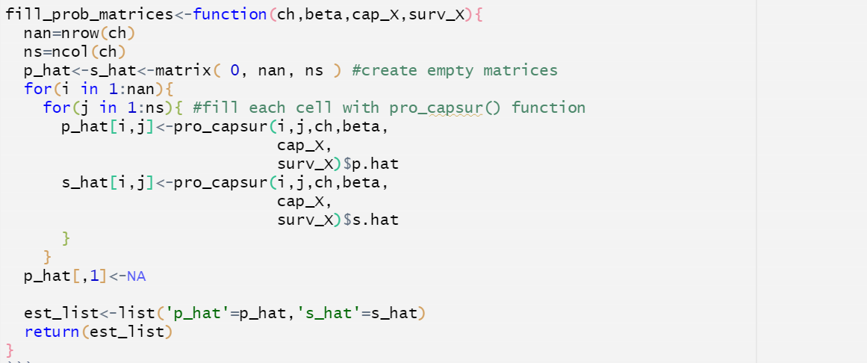

Coding – fill_prop_matrices()
Function to create matrices of $p_{ij}$ and ${\text{φ}}_{ij}$ for our observed data.

Slide 34
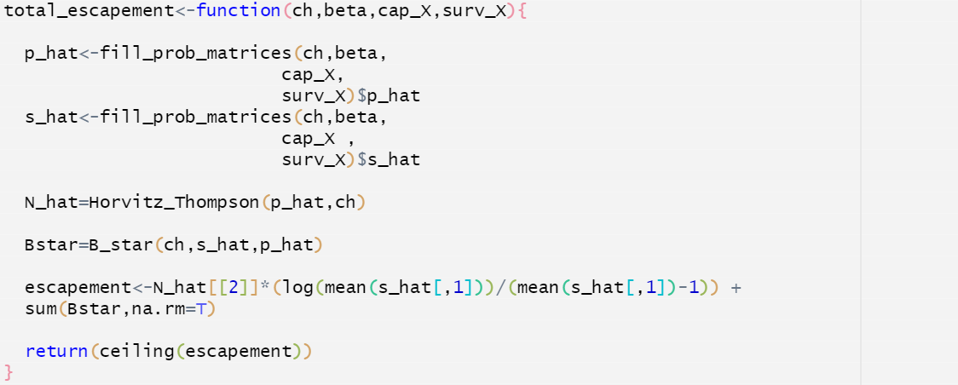
Coding – total_escapement()
Function to take optimized parameters and previously built functions to estimate total escapement.

Slide 35
Running code – estimate escapement
Run est_escapement() with optim_beta and prepped data.
optim_speed1 ~ 3.56 seconds.

Slide 36
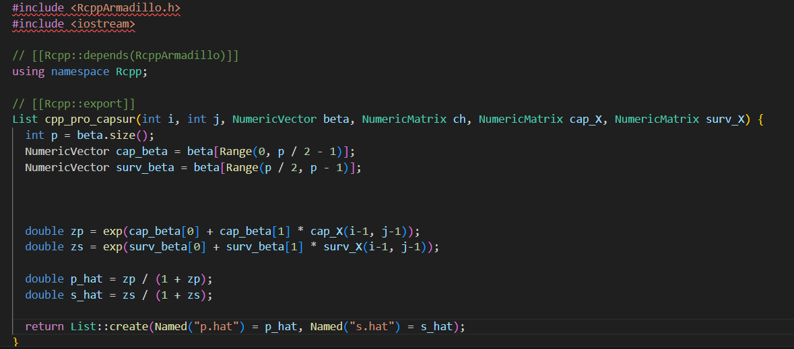
Speeding it up – incorporating C++
Notes:
In the C++ script, functions marked with Rcpp::export are pulled into our R environment and made available.

Slide 37
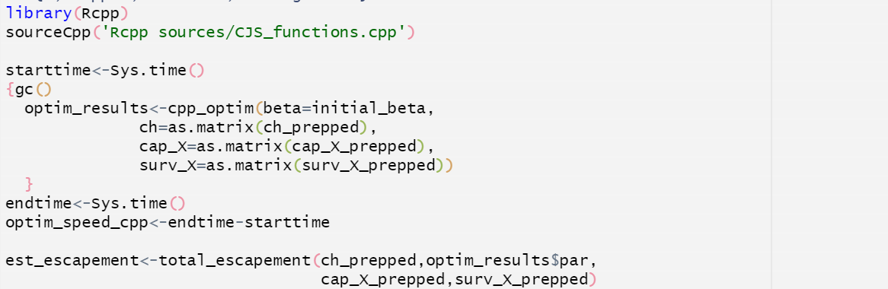
Speeding it up – incorporating C++
New optim_speed_cpp ~ 0.51 seconds.
Notes:
One important note is that C++ and R indexes matrices differently. With R, the first cell in a matrix is indexed at matrix[1,1], starting at 1, while in C++, the first cell in a matrix is indexed at matrix[0,0], starting at
0

Slide 38
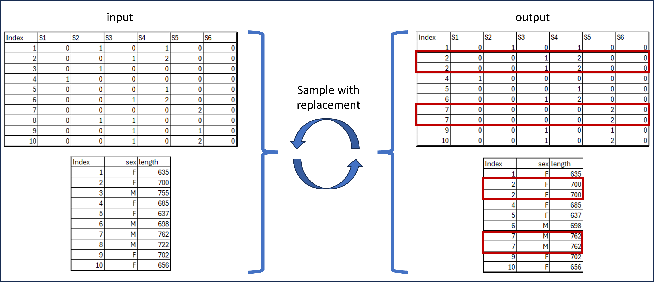
Bootstrapping for confidence intervals
Iterative resampling technique used to estimate distribution of the escapement estimate.

Slide 39
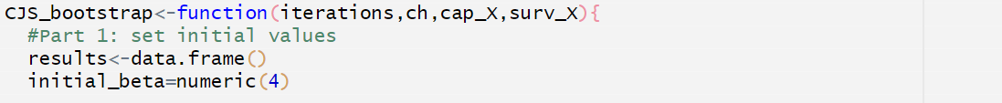
Coding – CJS_bootstrap
Input “iterations” and prepared data.
Sets initial values

Slide 40
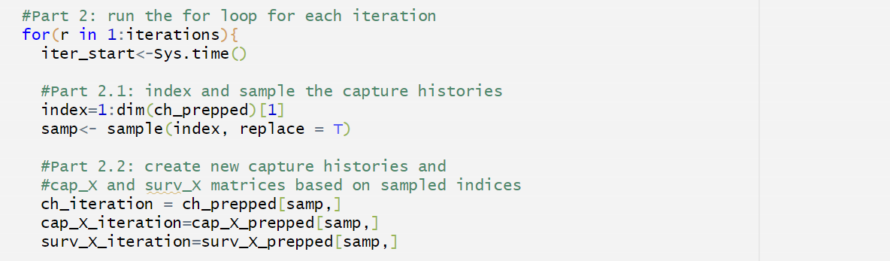
Coding – CJS_bootstrap
Begins for loop for target iterations.
Sample original prepped data with replacement.
Create new “iteration” data sets.

Slide 41
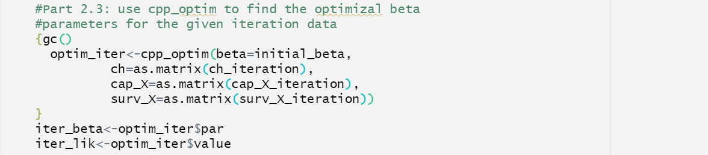
Coding – CJS_bootstrap
Use cpp_optim() to find optimized parameters for each iteration.

Slide 42
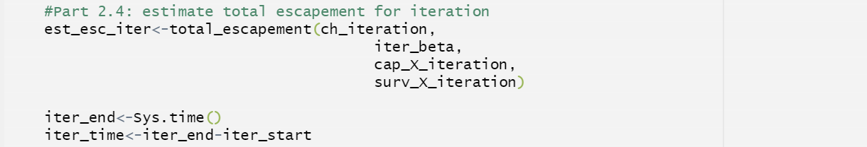
Coding – CJS_bootstrap
Run total_escapement() function using iteration data and parameters.

Slide 43
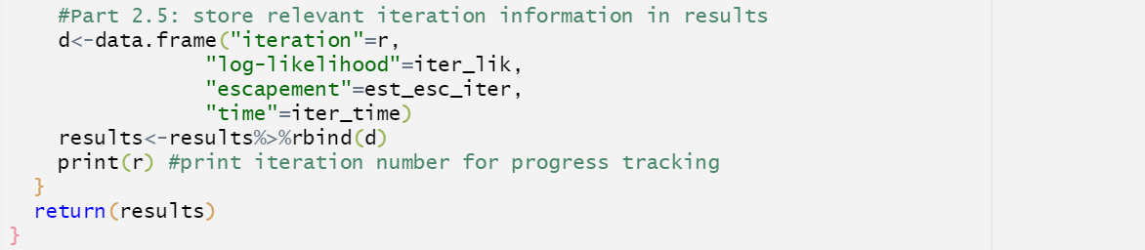
Coding – CJS_bootstrap
Store iterative results.
End for loop and return results.

Slide 44
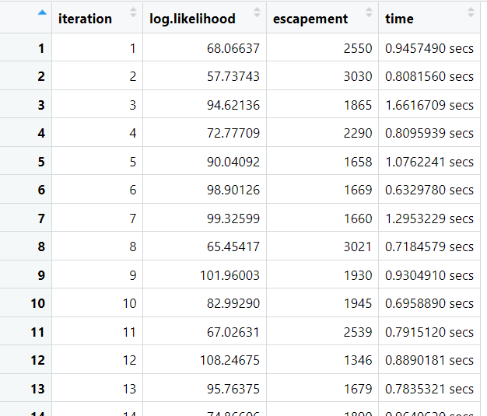
Running code – CJS_bootstrap
bootstrap_results()
Iteration number
Log-likelihood
Escapement estimate
Iteration duration

Slide 45
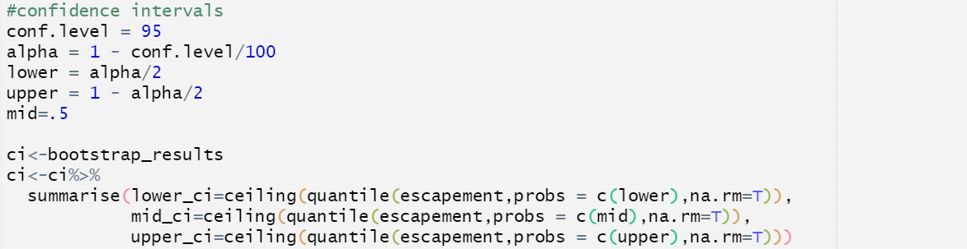
Running code – calculating CI

Slide 46
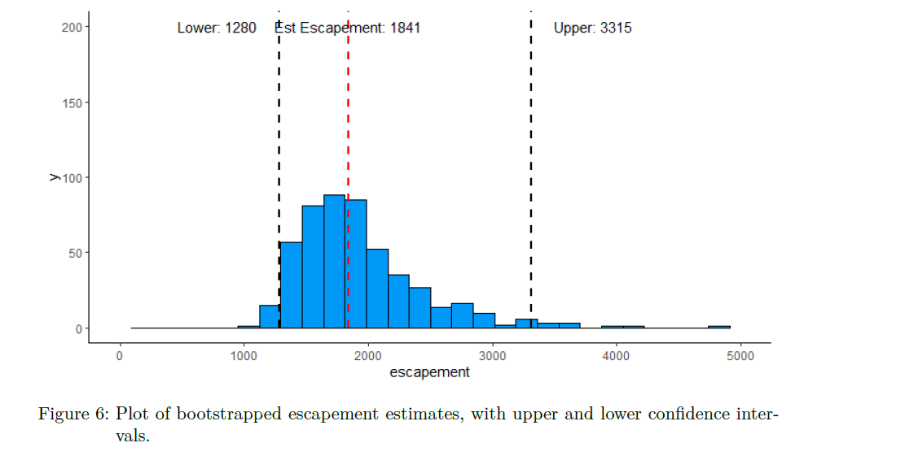
Bootstrapping results

Slide 47

A methods issues
Small sample sizes can cause confusing outputs.
Example: total fish marked or chopped is 33.
Bootstrapping produces estimates below known number of fish.
Notes:
Now, moving away from just the escapeMR package itself, one issue I’ve run into recently has to do with the super-population method itself, and problems with bootstrapping the confidence intervals when using very small sample sizes. For example, I had a dataset with a total of 33 carcasses observed over a 10 week survey period, 15 of those carcasses were marked and released for recapture, 18 were chopped on initial capture. You can see in the plot here that the abundance estimate of the total population was 43, which seems reasonable. However, several of the bootstrapped intervals produced estimates that were below the known number of observed carcasses, 33 which doesn’t make sense initially.
This occurs because the super-population model relies on the capture probabilities and survival probabilities to estimate the number of fish arriving into the system and doesn’t necessarily utilize the actual observed counts. When bootstrapping occurs, what happens is we are resampling, with replacement, the original dataset. So at very low sampling sizes, individual capture histories will have more of an impact on the probabilities of capture and survival. And then if our overall probabilities of survival and capture are high, our estimate of abundance will be low.
scussion in the future.
This is an issue in applying the super-population model at low sample sizes, and so it’s important to know what is happening behind the scenes if you see this problem in your results. It may or may not be something we should correct for, but is probably worth a di

Slide 48
Wrapping up
Recreated CVCS escapement model in R code.
Only difference to escapeMR() is optimization algorithm.
Use Rcpp to speed up optimization.
Use bootstrapping to produce confidence intervals of estimate.

Slide 49
Questions?

